Slide 1

By James Ehiabhi

Slide 2

SALES AND TRANSACTION REPORT BY PERIOD
Power BI Desktop
Year

Total sales over the period amount to $2,297,200.86 and total number of transactions is 5009
All 
How sales trended over the month Average sales by day of the week
^{0.4M} Range 216.30 259.68
300
Region 
All 
0.3M
0.2M
200
Category 
0.1M
100
All 
January
February
March
April
May
June
July
August
September
October
November
December
0
Mon Tue Wed Thu
Fri
Sat Sun
How customer segments rank over the Months
Segment Consumer Corporate Home Office
0.4M
No transactions by day of the week
Range 182 920
1,000
0.2M
500
0.0M
January
February
March
April
May
June
July
August
September
October
November
December
Month
0
Mon Tue Wed Thu Fri
Sat Sun

Slide 3
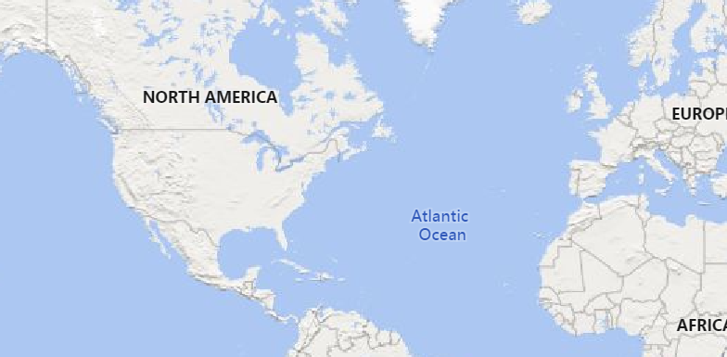

SALES AND TRANSACTION REPORT BY LOCATION
Power BI Desktop
Year

Total sales over the period amount to $2,297,200.86 and total number of transactions is 5009
Top 10 state by sales Percentage of transaction shipment of the top 10 states
All 
State First Class Same Day Second Class Standard Class
Region 
California
California | 16.06% | 5.39% | 19.69% | 58.86%
Florida | 14.00% | 5.50% | 18.00% | 62.50%
Illinois | 15.22% | 3.26% | 18.84% | 62.68%
Michigan | 11.11% | 5.98% | 21.37% | 61.54%
New York | 14.23% | 4.98% | 19.57% | 61.21%
Ohio | 19.92% | 8.05% | 21.61% | 50.42%
Pennsylvania | 18.06% | 4.51% | 16.67% | 60.76%
Texas | 15.61% | 5.75% | 19.92% | 58.73%
Virginia | 24.35% | 2.61% | 17.39% | 55.65%
Washington | 12.11% | 6.25% | 21.09% | 60.55%
New York
Texas Washington Pennsylvania
Florida Illinois Ohio Michigan Virginia
All 
Category 
All 
0.0M
0.2M
0.4M
Bottom 10 state by sales
Sales Distribution by city
North Dakota West Virginia
Maine South Dakota Wyoming
District of Columbia
Kansas Idaho Iowa
New Mexico
0K
2K
4K
© 2024 TomTom,, © 2024 Miiccrrossofftt Corrporrattiion,, © OpenSttrreettMap

Slide 4
AI-POWERED Q&A CHATBOT FOR FURTHER EXPLORATION
Power BI Desktop
Year

Total sales over the period amount to $2,297,200.86 and total number of transactions is 5009
All 
Back to default
 Help Q&A understand people better by adding synonyms. Add synonyms now 

Ask a question about your data  
Try one of these to get started
Top 5 states by sales
Show all suggestions

Slide 5


I am happy to receive your feedback and suggestions 😉👌

